Slide 1
Single-channel models APVSG vs competitors before 6 GHz, part 1

Slide 2
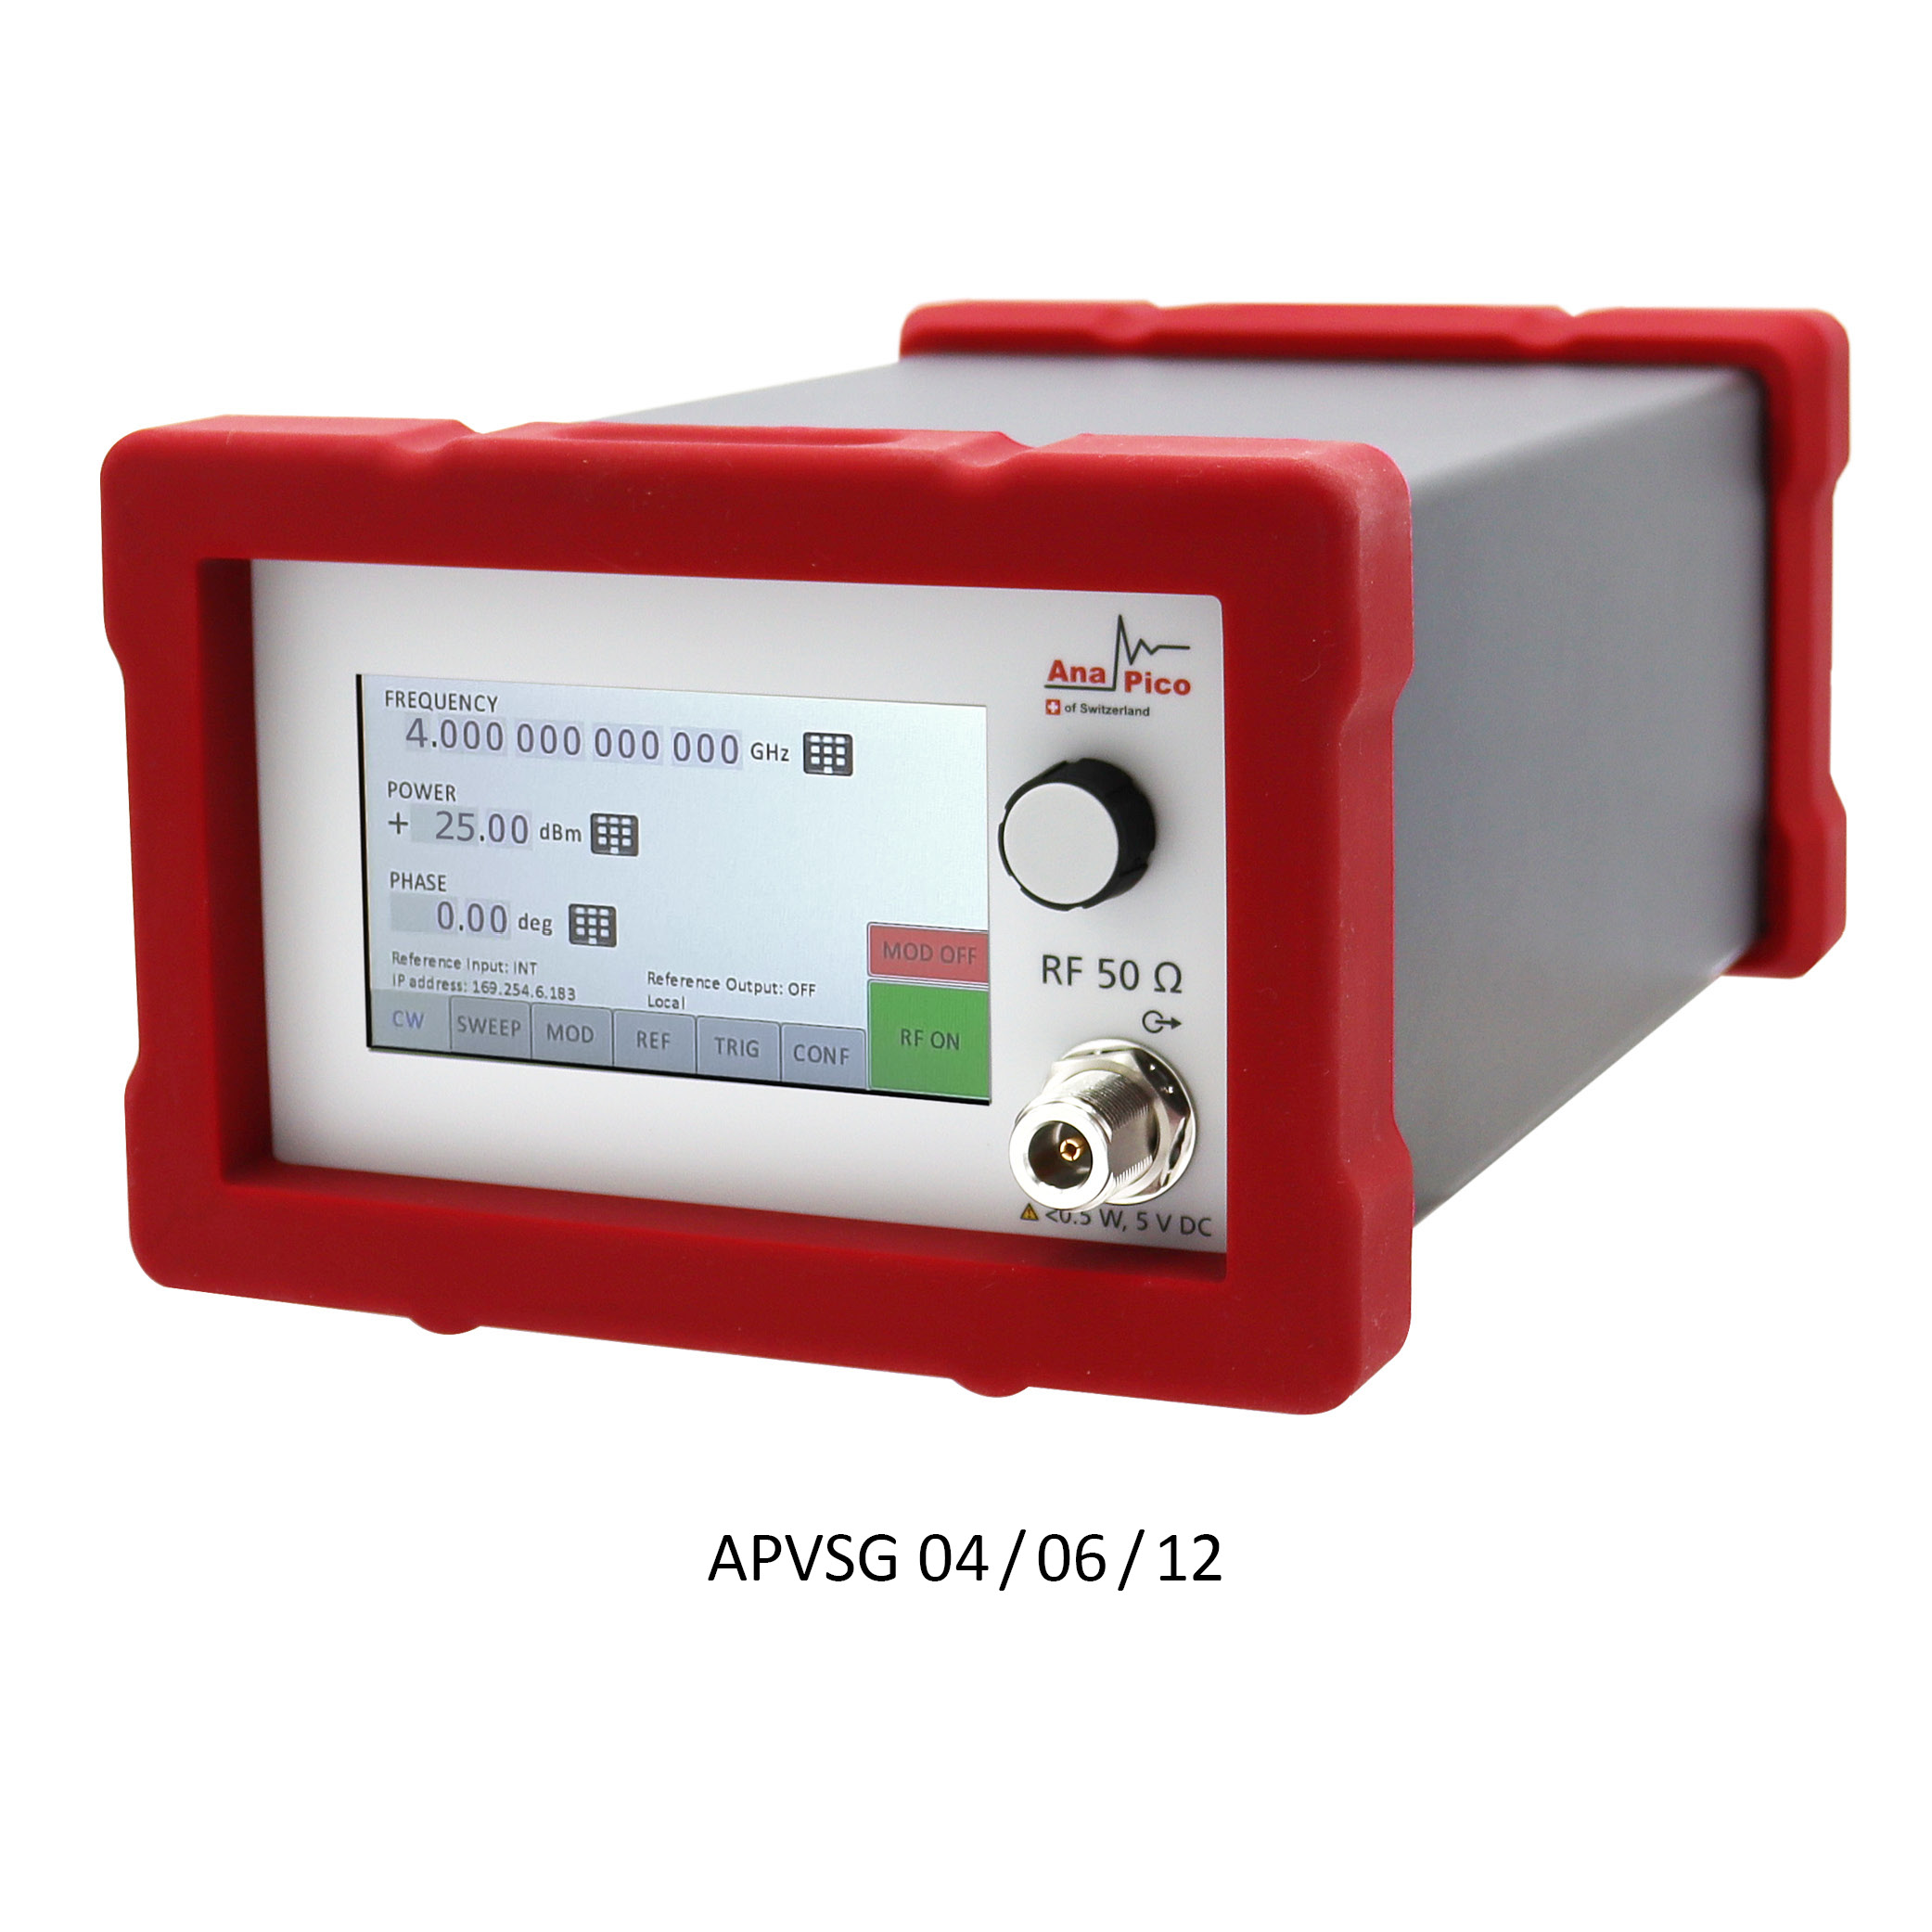
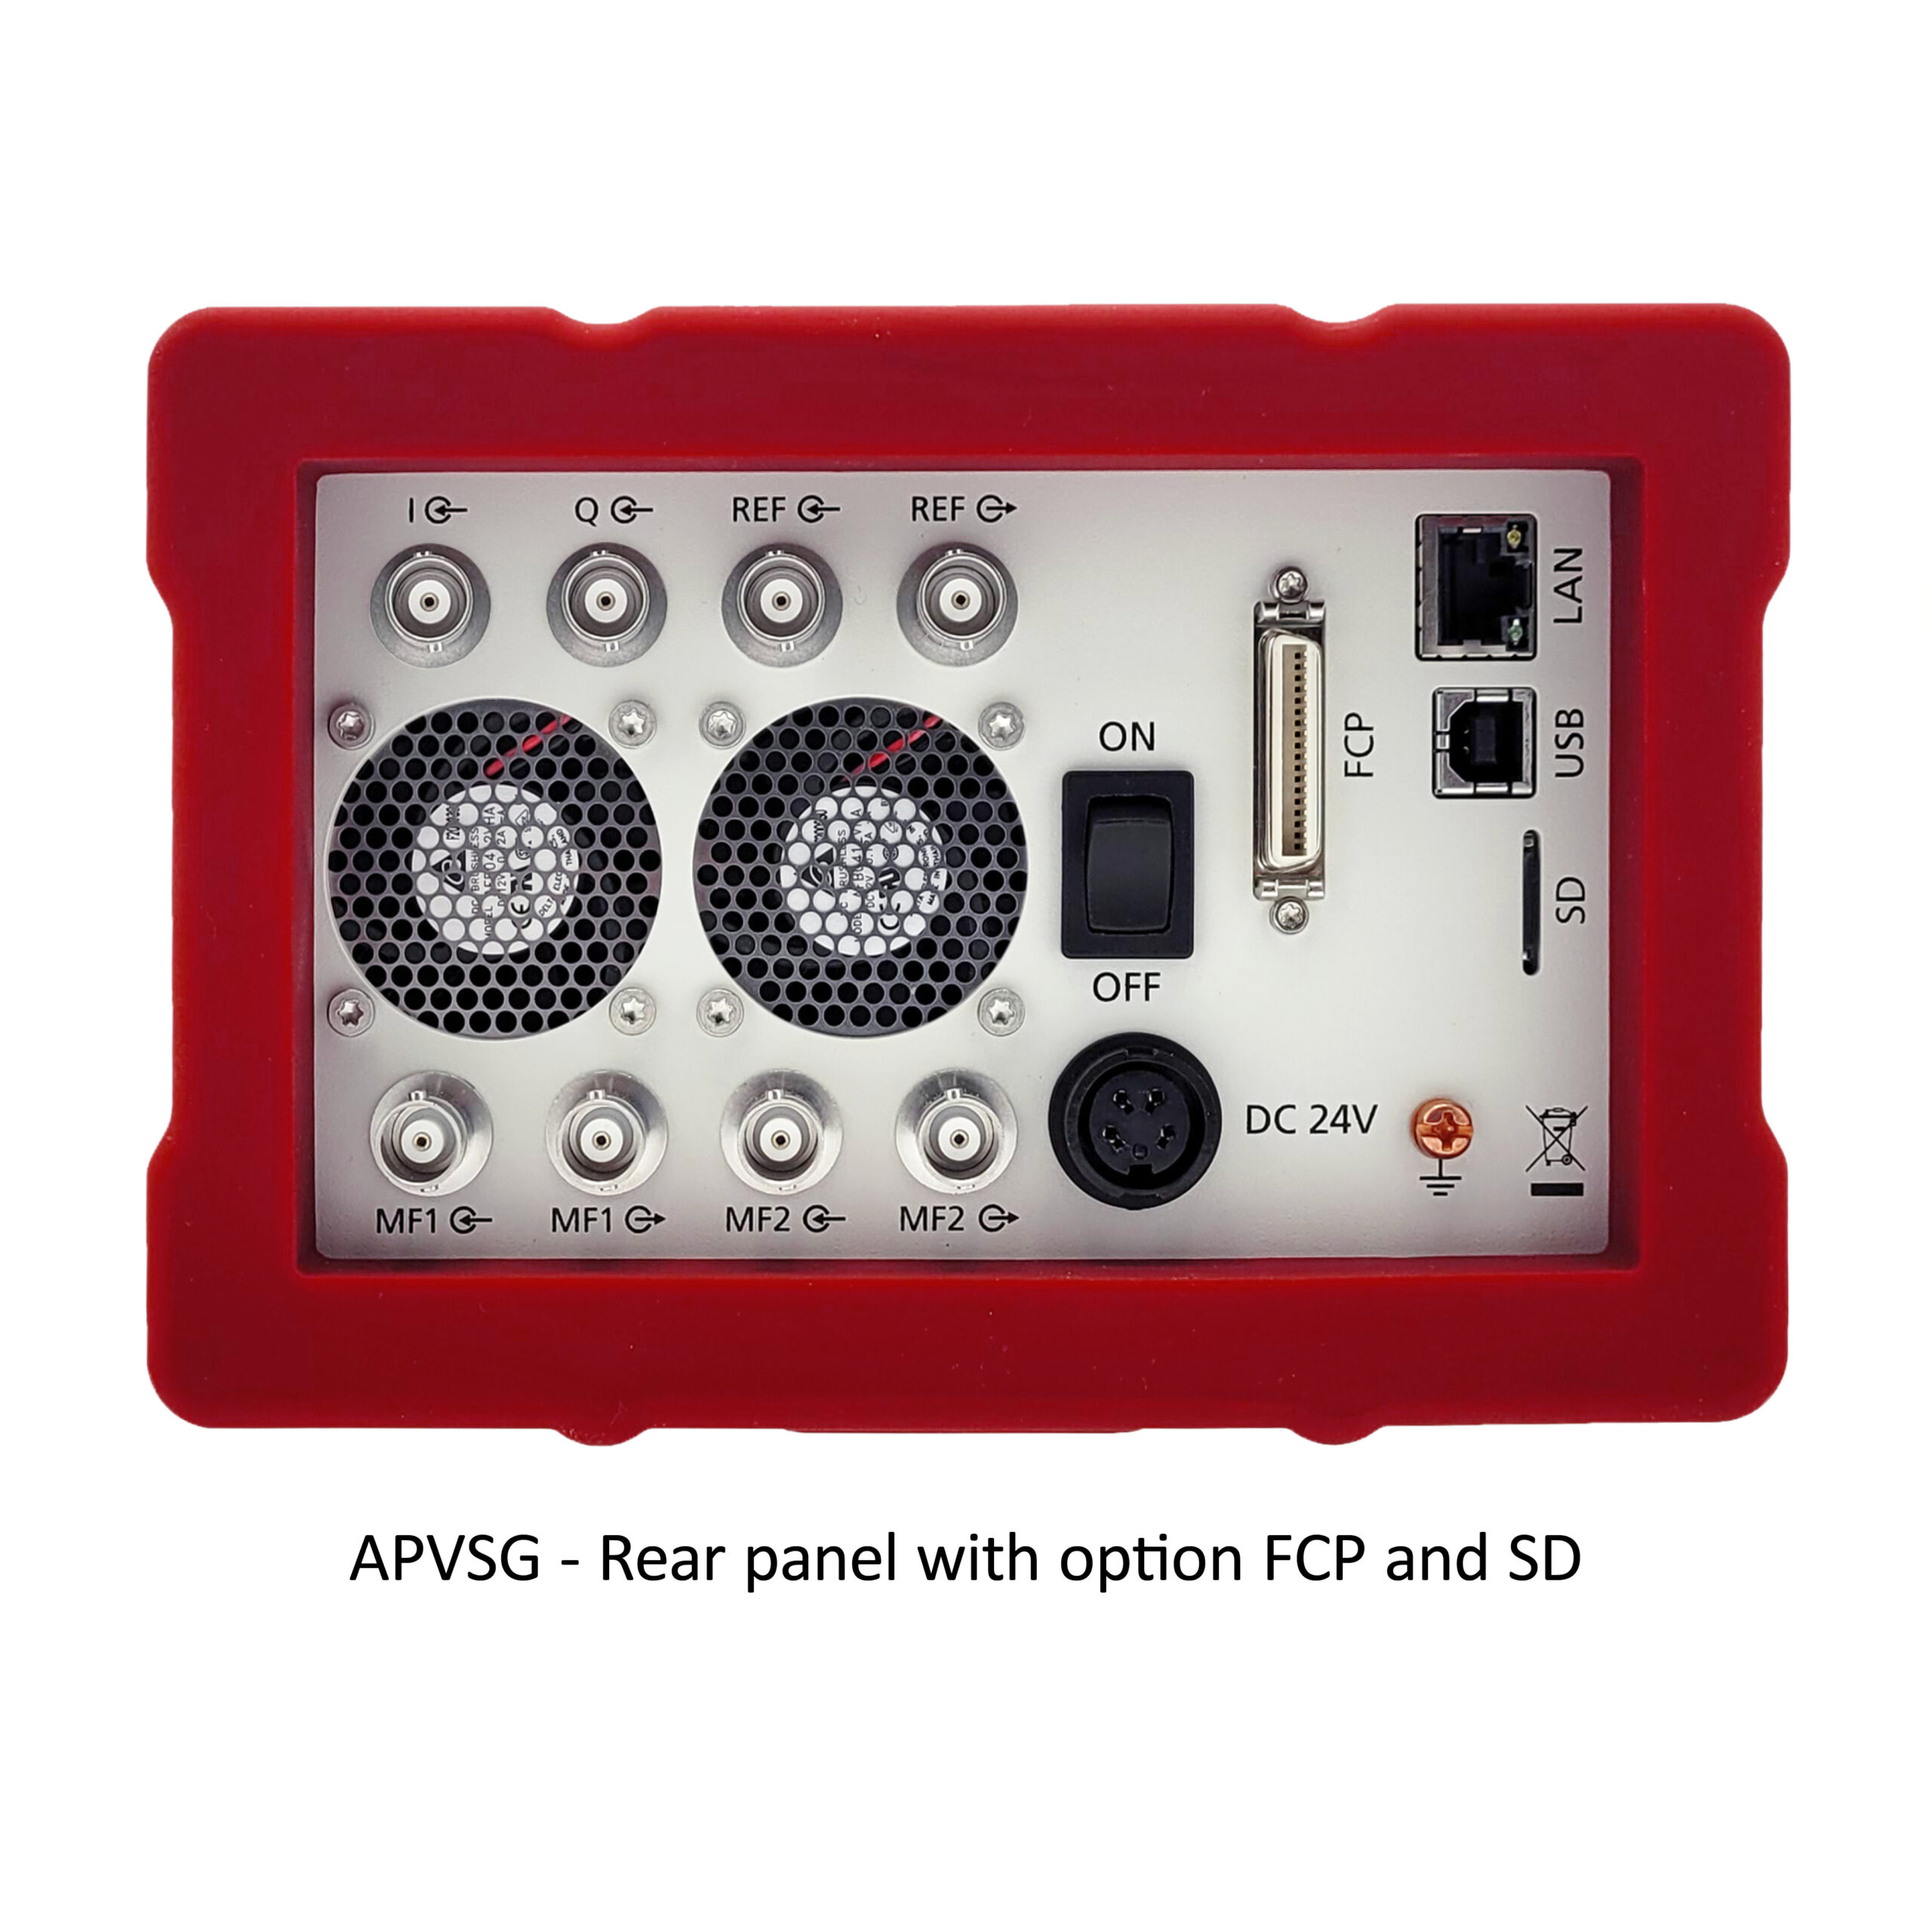
APVSG

Slide 3
Model | APVSG4,6 | N5182B | N5172B | N5176B
 | ANALOG RF PART
Frequency range | 100 kHz to 4, 6 GHz | 5 MHz (IQ Mode) to 3, 6 GHz | 5 MHz (IQ Mode) to 3, 6 GHz | 5 MHz (IQ mode) to 3, 6 GHz
Number of channels | 1-2-3-4 | 1 | 1 | 1
Min. power | -120 dBm (mechanical attenuator) -55 dBm electronic attenuator | -127 dBm, mechanical attenuator | -127 dBm, mechanical attenuator | -144 dBm, mechanical attenuator, guaranteed -110 dBm
Max. power | W/O attenuator/ Attenuator | W/O attenuator/ Attenuator | W/O attenuator/ Attenuator | W/O attenuator/ Attenuator
1 GHz | +22|+17 | 24|+18 | 24|+18 | +13
3 GHz | +18|+15 | +24|+16 | +24|+16 | +18
6 GHz | +22|+15 | +18|+16 | +18|+16 | +16

Slide 4
Model | APVSG4,6 | N5182B | N5172B | N5166B
Phase noise 1 GHz 20 kHz offset | -145 dBc/Hz | -134 dBc/Hz|-146 dBc/Hz Option UNX | -122 dBc/Hz | -119 dBc/Hz
Aging per year | 1 ppm, 0.03 ppm, 0.02 ppm | 0.1 ppm | 1 ppm | 1 ppm
Switching speed Analog part | 500 μs standard, < 2 μs UFS option | 5 ms, 950 μs option UNZ | 5 ms, 950 μs option UNZ | 5 ms
Switching speed in Baseband mode | 500 μs standard ,< 100 ns UFS option | 5 ms, option UNZ ≤ 1.05 ms | 5 ms, option UNZ ≤ 300 μs | 5 ms
Harmonics | -40 dBc | -35 dBc, f>3 GHz non guaranteed | -35 dBc, f>3 GHz non guaranteed | -35 dBc, f>3 GHz non guaranteed
Nonharmonics 1,3,6 GHz (typ.) | -90|-80|-70 dBc | -87|-81|-75 -92|-86|-80 UNY | -72,-66,-60 dBc | -72,66,60 dBc
Analog modulations | AM,FM,PM,PULSE, CHIRP | AM,FM,PM,PULSE | AM,FM,PM,PULSE | AM,FM,PM,PULSE

Slide 5
Model | APVSG4,6 | N5182B | N5172B | N5166B
Pulse modulation Min.width/ Rise time | 0-10 ns| 5 ns typ. | 20 ns/ 7 ns | 20 ns/ 7 ns | 20 ns/ 7 ns
Minimum pulse width with ALC on | <10 ns | 2 µs | 2 µs | 2 µs
IQ MODULATOR PARAMETERS
Bandwidth, IQ | 400 MHz | 200 MHz | 200 MHz | 200 MHz
Frequency response | <± 1,0 dB typ | ± 0.2 dB (160 MHz) | ± 0.2 dB (160 MHz) | ± 0.2 dB (160 MHz
Carrier Leakage | -90 typ, -70 dBc | Non specified | Non specified | Non specified
Suppression of Image sideband in modulation bandwidth | -85 typ, -65 dBc | Non specified | Non specified | Non specified

Slide 6
Model | APVSG4,6 | N5182B | N5172B | N5166B
BASEBAND GENERATOR
Bandwidth | 400 MHz | 80 MHz option 656 160 MHz option 656-657 | 80 MHz option 656 160 MHz option 656-657 | 60 MHz option 653 120 MHz option 653+655
Sample-rate | 500 MHz | 100 MHz option 656 200 MHz option 657 | 100 MHz option 656 200 MHz option 657 | 75 MHz 150 MHz
Memory of BB Generator (Playback) | 512 MSample | 32 MSa, 512 MSa option 022, 1024 MSa option 023 | 32 MSa, 512 MSa option 022, 1024 MSa option 023 | 32 MSa, 512 MSa option 022
Symbol rate | 10 s/s to 200 MS/s | 50 Sp/s to 100 MS/s | 50 S/s to 100 MS/s | 50 S/s to 100 MS/s
EVM 16QAM 2.5 GHz, 0 dBm | 0,4% typ | 0,65% | 0,65% | 0,65%
BASEBAND GENERATOR (SEGMENTED MEMORY MODE)
Number of segments | 1 to 65 k | 1 - 8192 | 1 - 8192 | 8192
Sequencer Play List Length | 1 to 2048 | 2000 | 2000 | 2000
Sequence Segment Repetitions | 1 to 10 M | 65,535 | 65,535 | 65,535

Slide 7
Model | APVSG4,6 | N5182B | N5172B | N5166B
Multi-tone mode
Number of carriers | 1 to 1 000 | Up to 100 | Up to 100 | Up to 100
Frequency offset | -200 to 200 MHz | -80 to +80 MHz | -80 to +80 MHz | -60 to +60 MHz
Power offset | -60 dB to 0 dB | -40 to 0 dB | -40 to 0 dB | -40 to 0 dB
Additive White Gaussian Noise
Сrest Factor | ≤ 21.07 dBm | 15 dB | 15 dB | 15 dB
Carrier to Noise Ratio C/N | -60 to 90 dB | ± 100 dB | ± 100 dB | ± 100 dB
Digital modulation
Digital modulations | QAM, supporting alternative libraries in the format .qid, .qim, .qis, .qi | LTE/LTE, W-CDMA/HSPA+, cdma2000/1xEV-DO, GSM/EDGE/Evo, Bluetooth, DFS and DAA , Global Navigation Satellite System (GNSS), IoT, WiMAX, 5G NR, LMR, PSK, QAM, FSK, MSK, ASK, TETRA

Slide 8
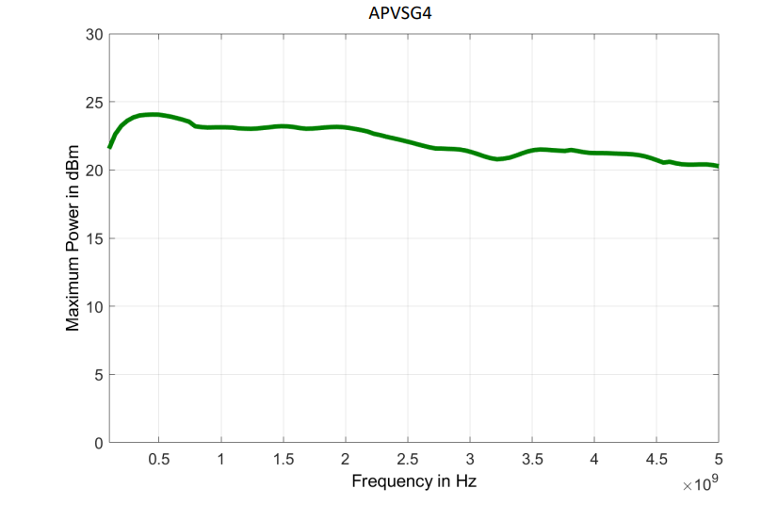
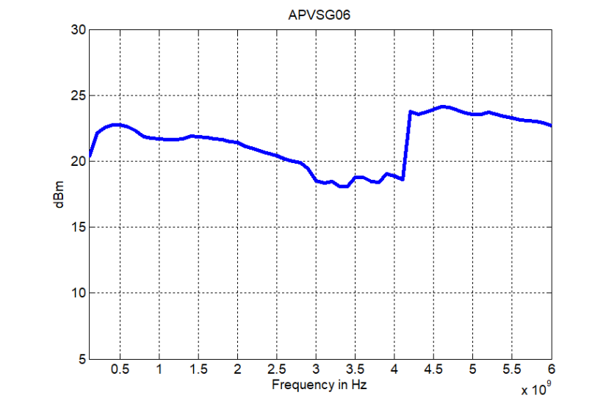
Max. power AnaPico
AnaPico APVSG04
AnaPico APVSG06

Slide 9
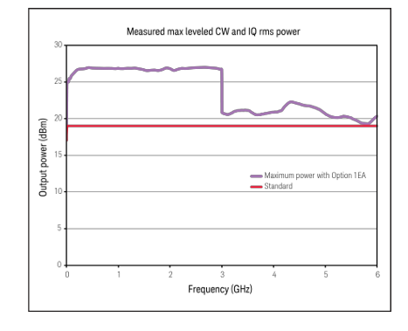
Max. power Keysight N5172B, N5182B, N5166B
Keysight N5172B, N5182B
Keysight N5166B

Slide 10
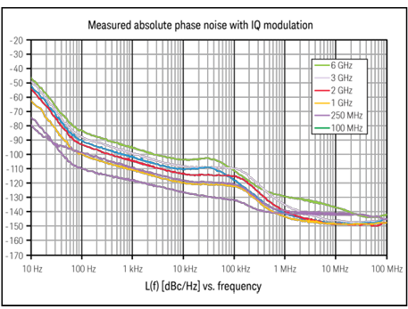
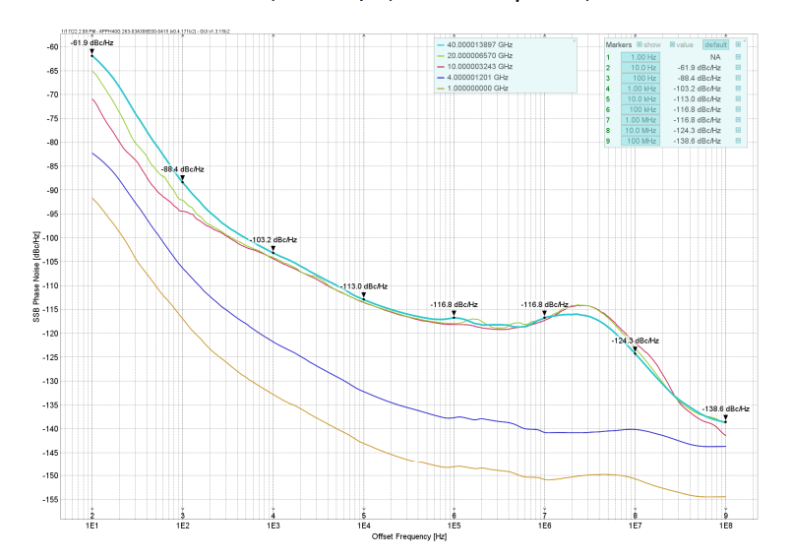
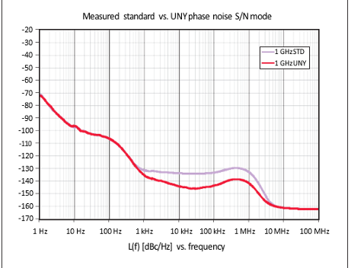
Phase noise APVSG vs N5182B, N5172B
AnaPico APVSG, without LN
Keysight N5172B
Keysight N5182B

Slide 11
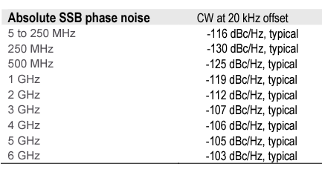
Phase noise APVSG vs N5182B, N5172B
AnaPico APVSG, without LN
Keysight N5166B

Slide 12
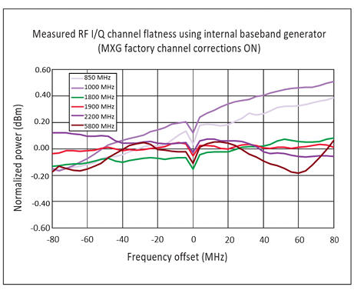
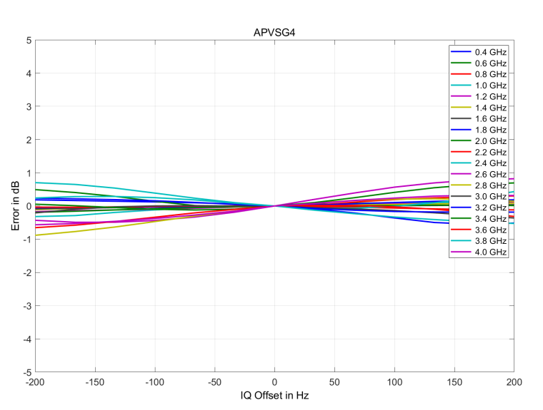
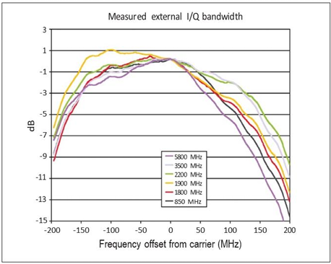
Frequency response IQ BB, AnaPico vs Keysight
AnaPico APVSG
Keysight N5182B,N5172B,N5166B
Keysight N5182B,N5172B,N5166B external BB

Slide 13
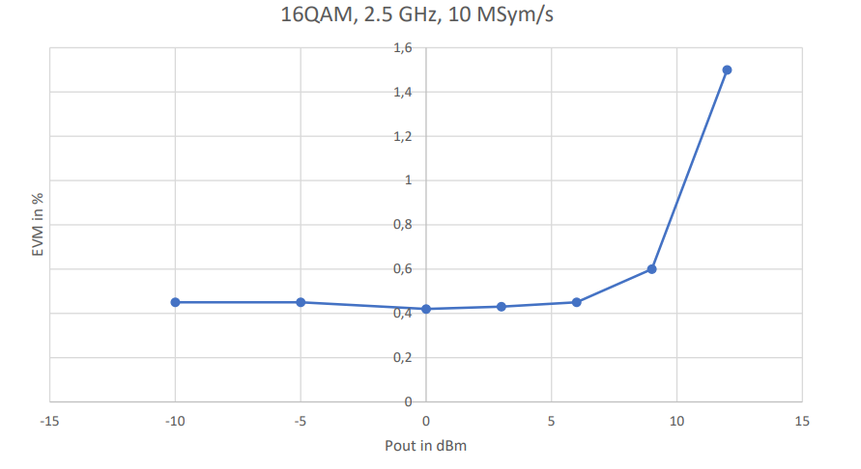
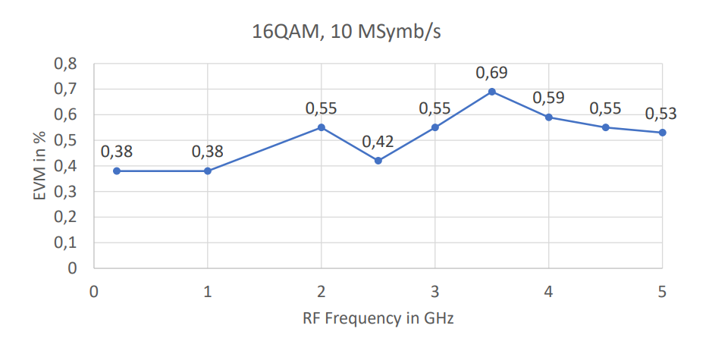
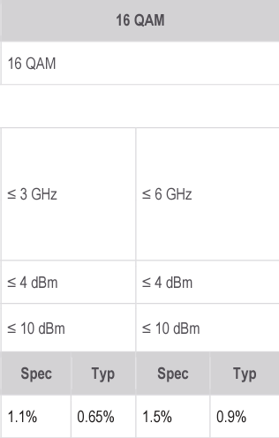
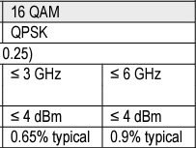
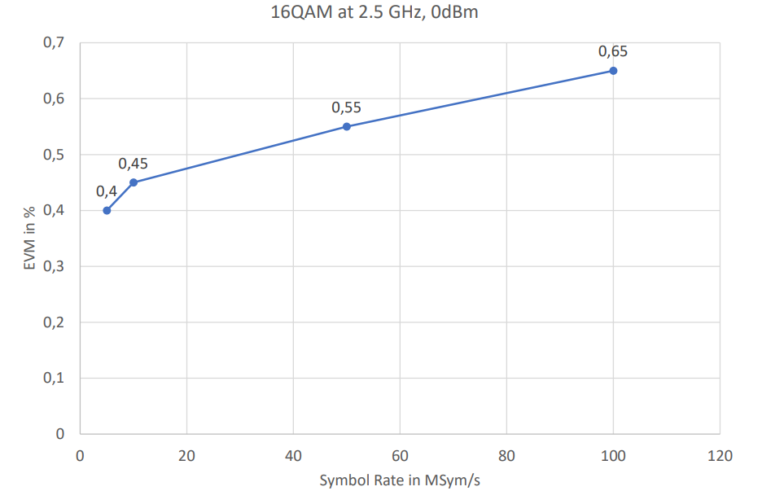
EVM 16QAM AnaPico vs Keysight
AnaPico APVSG
AnaPico APVSG
AnaPico APVSG
Keysight N5172B, N5182B
Keysight N5166B

Slide 14
Conclusion
Comparison of VSG could be done separately in several dimension: Analog RF part, IQ modulator, BB generator-overall performance and performance and quality of SW part and libraries.
Analog RF Part
Only AnaPico ready to propose in same product like single-channel and milty-channel units, customer could order 2-3-4 channels model instead of several units and save money, plus solutions will have excellent phase coherence.
Advantages AnaPico in Phase noise performance, similar phase noise could offer N5182B +UNX,UNY options, but price advated will be on AnaPico side in 30-35% price. Alternative Keysight models have 20 dB worse phase noise.
Best in class long-term stability of AnaPico APVSGxx SG, 0.02 ppm per year.
Best in class switching speed APVSGxx, for analog and digital mode.
Level of Max.power, harmonics and non harmonics comparable between models.
Only AnaPico support operation from external accumulator.
IQ Modulator
Highest Bandwidth APVSG 400 MHz vs 200 MHz from competitors
Keysight SG have better frequency response of IQ modulation, but only with internal Baseband correction mode. Within smaller IQ bandwidth 80 MHz for example, frequency response error same. See page 12.
Keysight non-specified carrier leakage and Suppression sideband, which limited unit for defense application. AnaPico and Rohde&Schwarz specify this parameters.
Baseband Generator
AnaPico APVSG has 2 times broader bandwidth 400 MHz
Keysight VSG with options have a bigger memory of BB Generator. But AnaPico have better segment mode performance.
AnaPico APVSG demonstrate the best IVM for 16QAM modulations relatively Keysight competitors.
Because of more modern FGPA, AnaPico have more advanced segment mode, number of segments bigger and AnaPico APVSG supports more segment repetitions.

Slide 15
Conclusion
Digital modulations
Strong advantages AnaPico in Multi-carrier mode, number of carries, frequency offset, power offset which accomplished with better carrier suppression and side-band rejection.
2) Keysight has Advantages in quantity of libraries LTE/LTE, W-CDMA/HSPA+, cdma2000/1xEV-DO, GSM/EDGE/Evo, Bluetooth, DFS and DAA , Global Navigation Satellite System (GNSS), IoT, WiMAX, 5G NR, LMR, PSK, QAM, FSK, MSK, ASK, TETRA, also all modulations performance specified in datasheets.
3) Anapico support IQ files from different manufactures, but don’t have own libraries.

Slide 16
Exclusive options for APVSG
Options without analogs on APVSG04, APVSG06
UFS – switching speed EB6 external battery operation
LN+ long term stability of 0.02 ppm
PE4 electronic attenuator, usually all have mechanical ones except SMA100B

